Slide 1
What Makes a Cinderella Team?
A Data-Driven Exploration of NCAA Tournament Underdogs
Speaker: Deniz U Zeran & Keyu Chen
Data Analysis & Visualization – May 2025

Slide 2
Goal: Identify traits of NCAA Cinderella teams (2013–2025)
Tools: Tableau (exploration) + Python (clustering)
Focus: What traits help underdog teams succeed?
Project Overview
Focus: What traits help underdog teams succeed?

Slide 3
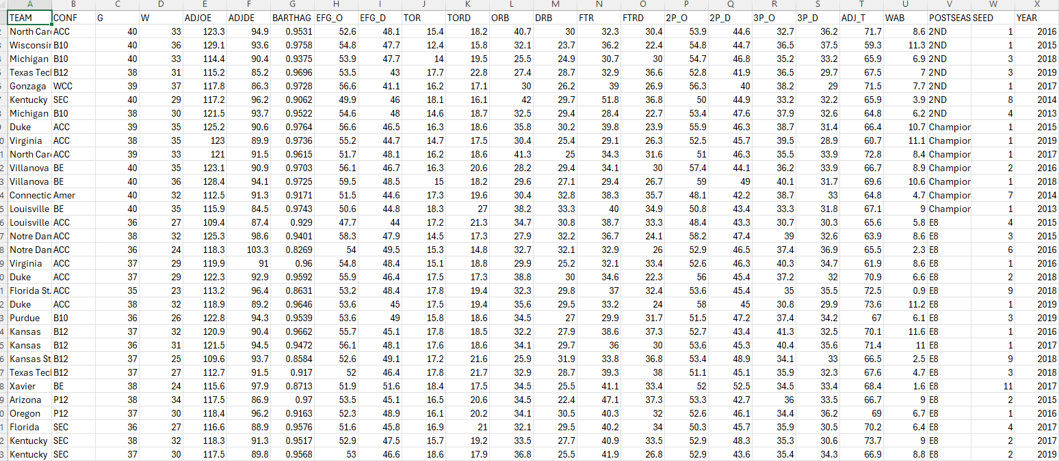
Dataset Summary
Source: Kaggle – NCAA Men’s Basketball data
Scope: 2,500+ teams, 13 seasons (2013–2025)
Metrics: ADJOE, ADJDE, WAB, BARTHAG, SEED, POSTSEASON

Slide 4
Important Metrics
Important Metrics in NCAA Tournament Analysis
Metric | Description
WAB | Wins Above Bubble – Measures performance beyond the tournament selection cutoff.
BARTHAG | Power Rating – Indicates a team’s overall strength relative to an average D-I team.
ADJOE | Adjusted Offensive Efficiency – Points scored per 100 possessions vs. average defense.
ADJDE | Adjusted Defensive Efficiency – Points allowed per 100 possessions vs. average offense.
EFG_O | Effective Field Goal % – Accounts for 3-point shooting in offensive efficiency.
EFG_D | Effective Field Goal % Allowed – Measures defensive shot quality control.
TORD | Turnover Rate Forced – Reflects a team’s defensive disruptiveness.
DRB | Defensive Rebound Rate – Measures how well a team ends opponents' possessions.
SEED | Tournament Seed – Indicates expectations and matchups.
POSTSEASON | Postseason Result – Reflects how far a team advanced in the NCAA Tournament.

Slide 5
Important Metrics
Key Cinderella Identification Metrics
Metric | Description
WAB | Reflects how much a team overperformed expectations relative to the bubble line.
BARTHAG | Indicates hidden team strength not reflected by seeding.
TORD | High values show the team forces many turnovers, disrupting stronger opponents.
DRB | High defensive rebounding limits second-chance points, often crucial for upsets.
ADJDE | Strong defense is a consistent characteristic of successful underdog teams.
SEED | Low seed number (≥10) is part of the Cinderella definition.
POSTSEASON | Used to confirm that the team made a deep run (Elite Eight or beyond).

Slide 6
Methodology-Python & Tableau
We used two complementary methods to study Cinderella teams
Method | Tool | Strengths | Role in Project
Visual Analysis | Tableau | Intuitive, interactive, great for spotting outliers & trends | Explore team performance & tournament patterns
Data Clustering | Python | Objective, repeatable, uncovers hidden structures in data | Group similar teams & detect Cinderella traits

Slide 7
Python Clustering – Methodology
Step-by-step process for identifying Cinderella candidates:
Selected 17 Numeric Performance Variables
Including ADJOE, ADJDE, BARTHAG, WAB, EFG%, TORD, DRB, etc.
Standardized Data
Used StandardScaler to remove bias from variable scales
Applied KMeans Clustering (k=5)
Grouped teams with similar overall profiles
Visualized with Radar Charts & PCA Scatter Plots
Radar Chart: shows cluster-level performance on all metrics
PCA: reduces 17 dimensions to 2 for easier visualization
Applied Cinderella filter: SEED ≥ 10 and POSTSEASON in ["E8", "F4", "CHMP"].

Slide 8
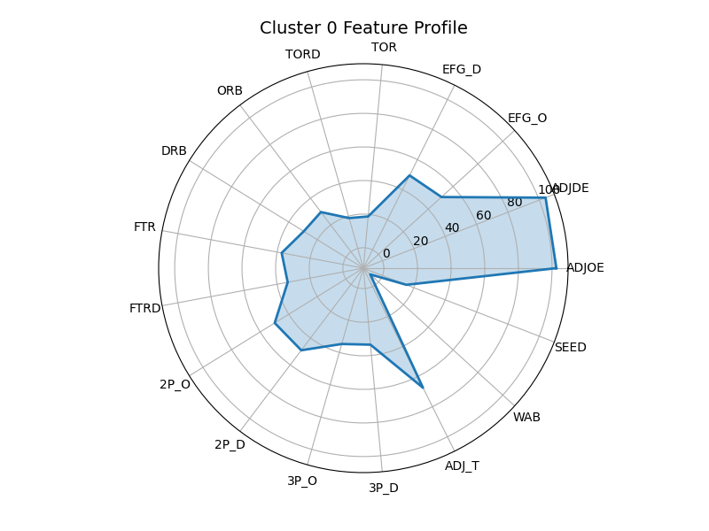
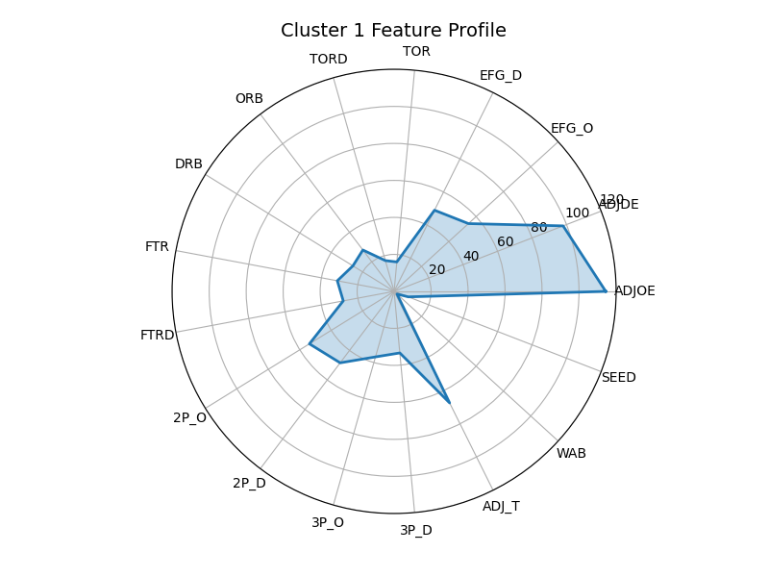

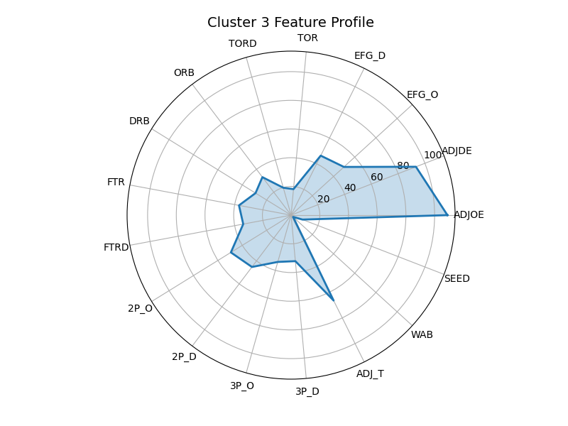
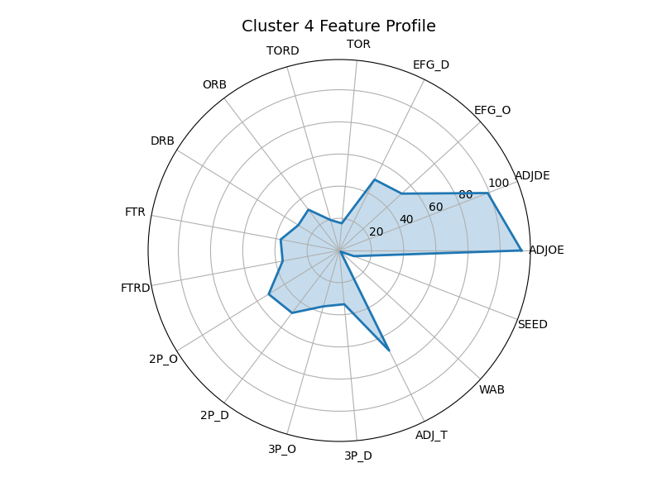
Clusters

Slide 9
Clusters
Cluster 0: Disruptive defense, high WAB – core Cinderella group
Cluster 1: Elite efficiency – top-seeded championship teams
Cluster 2: Weak across metrics – early exits
Cluster 3: Balanced but average – limited upside
Cluster 4: Mixed profile – some Cinderellas, inconsistent performance
Cluster | WAB | SEED | ADJOE | ADJDE | DRB | TORD | Interpretation Summary
0 | 1.63 | 9.08 | 111.6 | 96.3 | 30.06 | 20.22 | Mid-seed teams with disruptive defense – Cinderella potential
1 | 6.41 | 3.30 | 119.4 | 94.8 | 27.37 | 17.57 | Top seeds with elite efficiency – likely champions
2 | -6.74 | 15.29 | 102.2 | 103.6 | 29.69 | 19.26 | Weak overall metrics – frequent early exits
3 | 3.59 | 6.46 | 110.6 | 91.6 | 28.15 | 19.45 | Balanced but unremarkable – solid teams with limited upside
4 | -0.06 | 10.97 | 111.9 | 99.8 | 27.19 | 17.82 | Mixed profile – some Cinderella teams found here

Slide 10
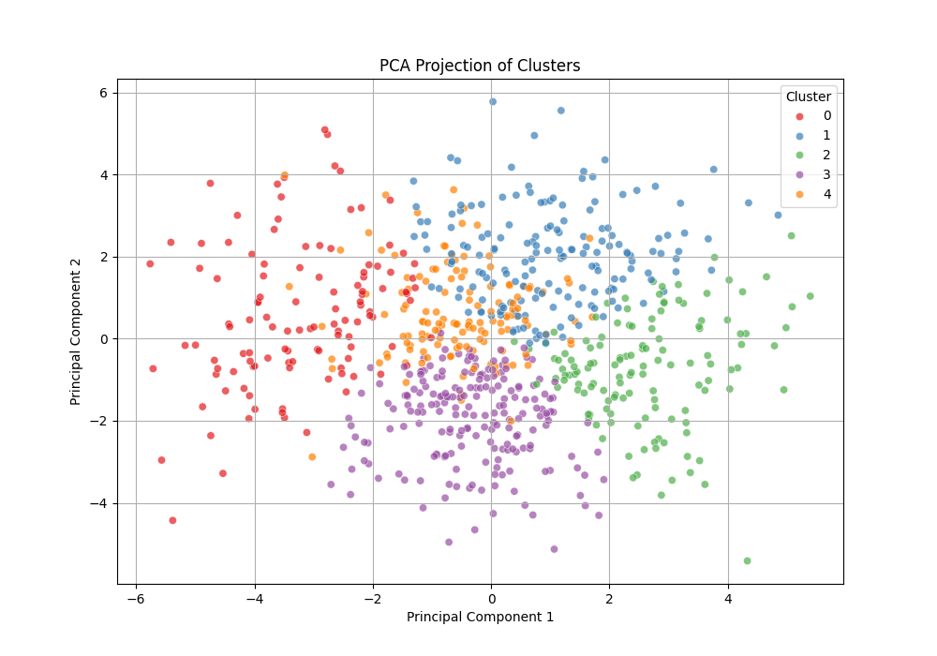
PCA Analysis
Principal Component Analysis (PCA) reduced the 17-dimensional dataset to two dimensions for visualization. The PCA scatter plot showed:
Cluster 1 (blue) is tightly grouped in the upper-right, indicating high consistency and strong team performance. These are championship-caliber teams.
Cluster 2 (green) is spread across the lower-right, showing poor defensive efficiency and low overperformance. Most teams here exit early.
Cluster 3 (purple) occupies the central area. These are balanced, middle-seeded teams with no standout metrics.
Cluster 0 (red) appears on the far left, with high TORD and DRB. These teams show overperformance and contain many Cinderellas.
Cluster 4 (orange) overlaps with Cluster 0 but is more centralized, reflecting mixed performance—some Cinderella cases appear here.
This dimensionality reduction validated the cluster structure and emphasized the internal variance within Clusters 0 and 4.

Slide 11
Cinderella Traits
Metric | Why It Matters | Target Value
WAB | Measures performance above tournament bubble | > 2.5
TORD | Forces turnovers, disrupts opponents | > 20%
DRB | Limits opponent second chances | > 70%
BARTHAG | Overall statistical strength | > 0.83
What Do They Have in Common?
Top Traits Found in Cinderella Teams (Clusters 0 & 4):
Summary: Cinderella teams often win not by offense—but by disruption, defense, and efficiency.

Slide 12
Cinderella Teams
Teams That Met Our Cinderella Filter
(Cluster 0 or 4 + Seed ≥ 10 + Reached Elite Eight or more)
Team | Year | Seed | Round | BARTHAG | Cluster
Xavier | 2017 | 11 | Elite 8 | 0.8713 | 4
Dayton | 2014 | 11 | Elite 8 | 0.8188 | 0
Syracuse | 2016 | 10 | Final 4 | 0.8857 | 0
Loyola Chicago | 2018 | 11 | Final 4 | 0.8444 | 4
UCLA | 2021 | 11 | Final 4 | 0.8350 | 4

Slide 13
Explanatory Visualizations in Tableau
Bar Chart: Tier vs. Round
Box Plot: BARTHAG by Seed Tier
Scatter Plot: ADJOE vs. ADJDE
Heatmap: Seed vs. Round
Parallel Coordinates + Team Table

Slide 14
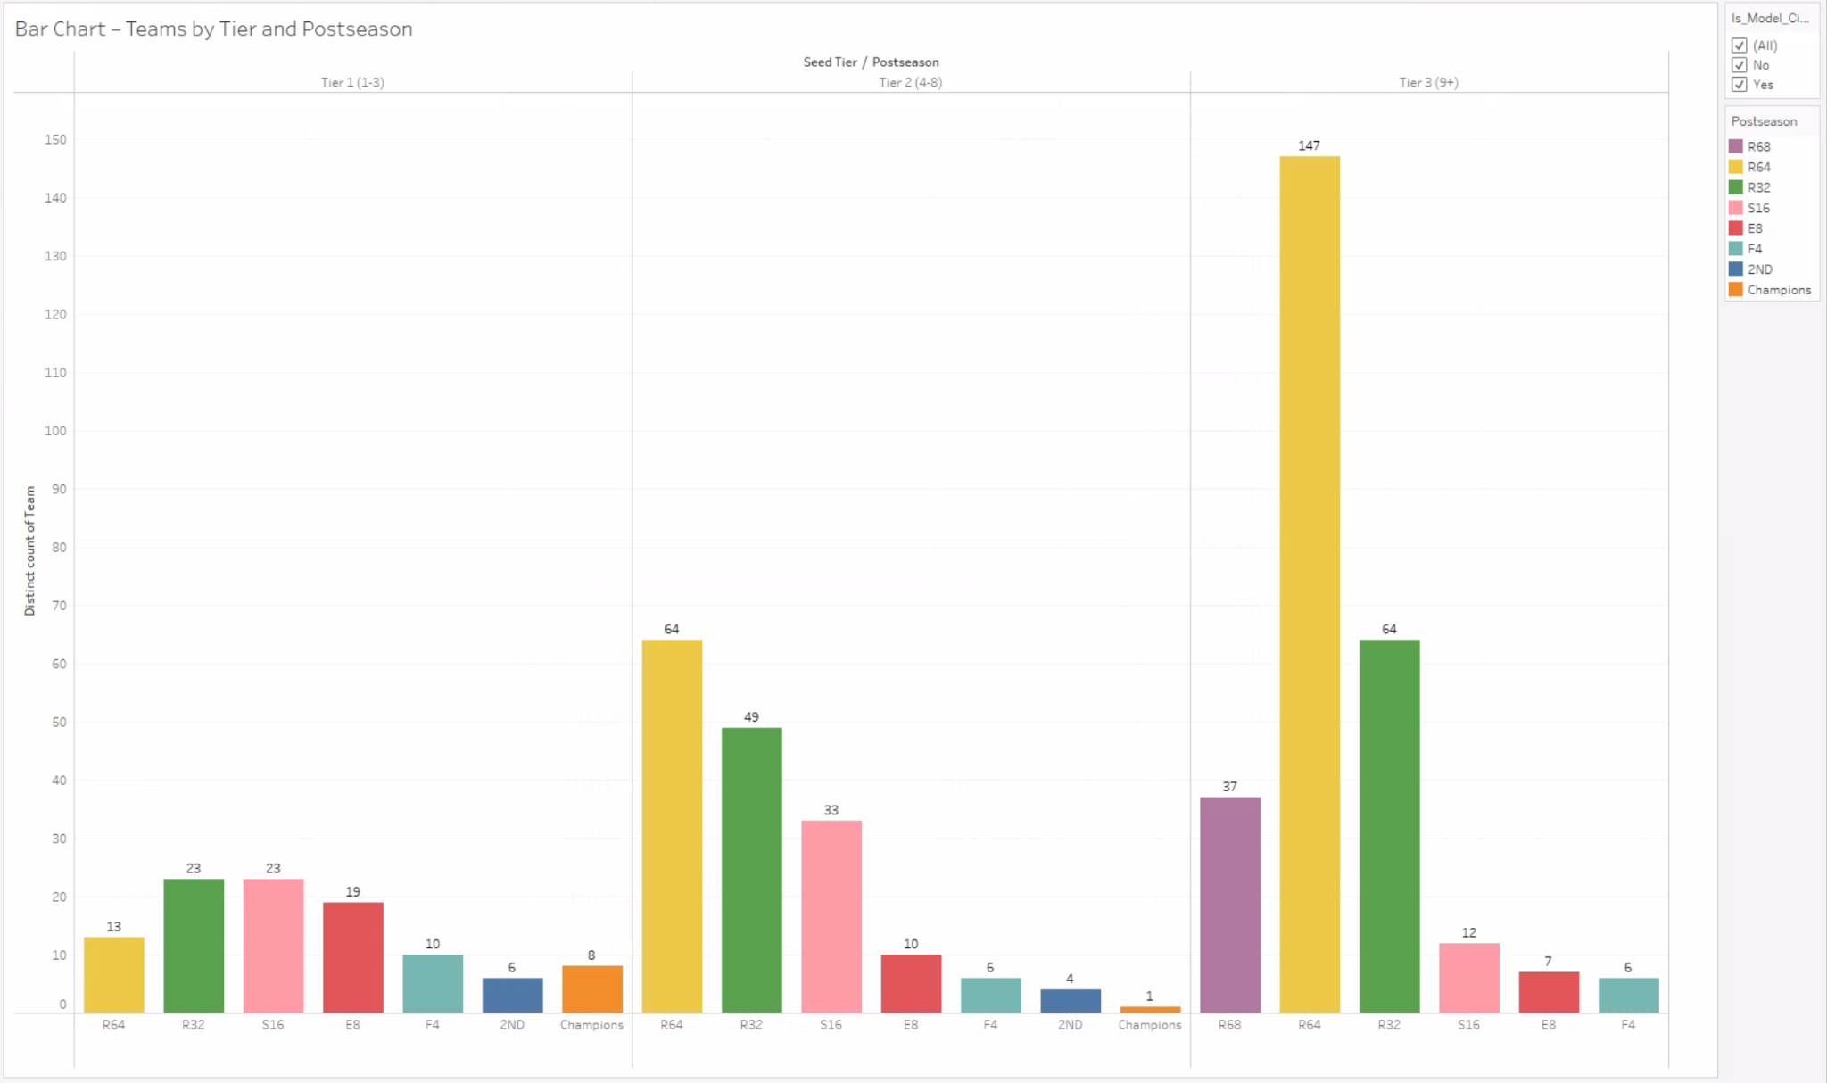
Tier vs. Postseason Performance
Tier 3 teams often reach the Sweet 16 or beyond, but rarely win the championship.
Tier 2 teams sometimes win the tournament, showing that deep runs aren’t limited to top seeds.
This supports focusing on Tier 2 and 3 teams as Cinderella candidates and validates our filter.
Notes:
Speaker Notes:
Tier 3 teams rarely win it all but often reach the Sweet 16 or deeper, which makes them viable Cinderella stories.
Tier 2 teams have occasionally won championships, proving deep runs aren’t just for top seeds.
This supports our decision to focus the model on Tier 2 and 3 teams as realistic Cinderella candidates.

Slide 15
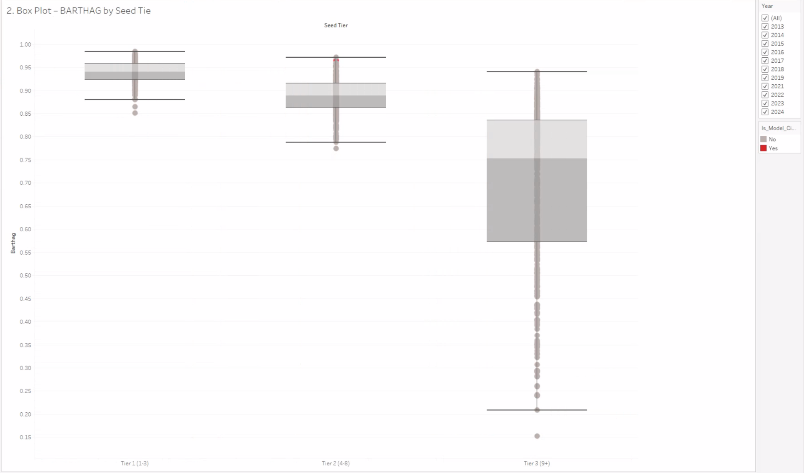
BARTHAG by Seed Tier
Tier 1 teams have the highest median BARTHAG, as expected.
Some Tier 2 and 3 teams have BARTHAG scores that overlap with Tier 1, showing hidden strength.
A BARTHAG above 0.83 signals strong Cinderella potential—even for lower-seeded Tier 3 teams.
Notes:
Speaker Notes:
Tier 1 teams predictably dominate in BARTHAG, but there’s surprising overlap with Tier 2 and 3 teams.
That overlap reveals teams that are statistically strong, despite a lower seed.
A BARTHAG above 0.83 is a signal to watch—even if the team is seeded 10 or lower.

Slide 16
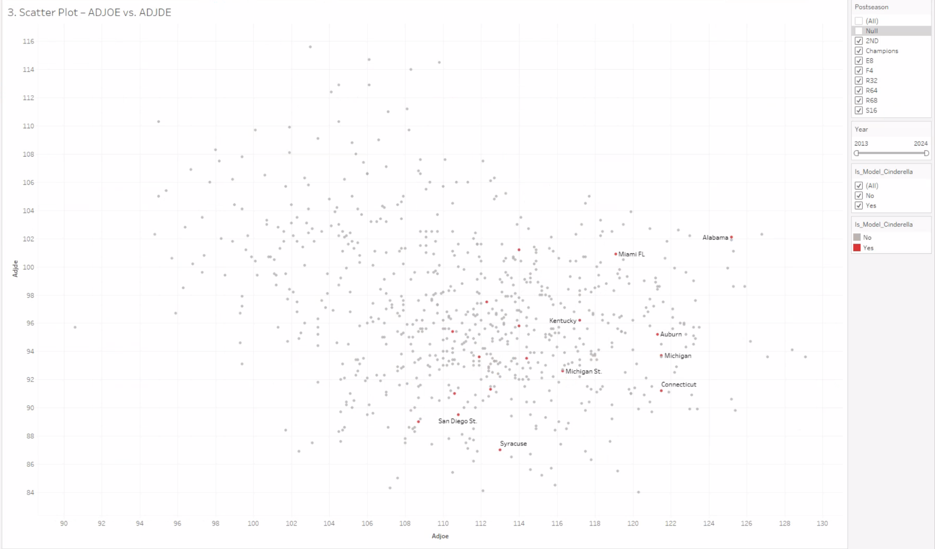
ADJOE vs. ADJDE
Champions excel in both offense and defense, clustering in the top-right quadrant.
Cinderella teams typically have strong defense and average offense.
The key to a Cinderella run is elite defense, not flashy scoring.
Notes:
Speaker Notes:
Champions tend to be elite on both ends, clustering in the top-right of our efficiency chart.
Cinderella teams lean heavily on defense—they often have top-tier adjusted defense but average offense.
This suggests the key to a Cinderella run is controlling pace, not scoring explosively.

Slide 17
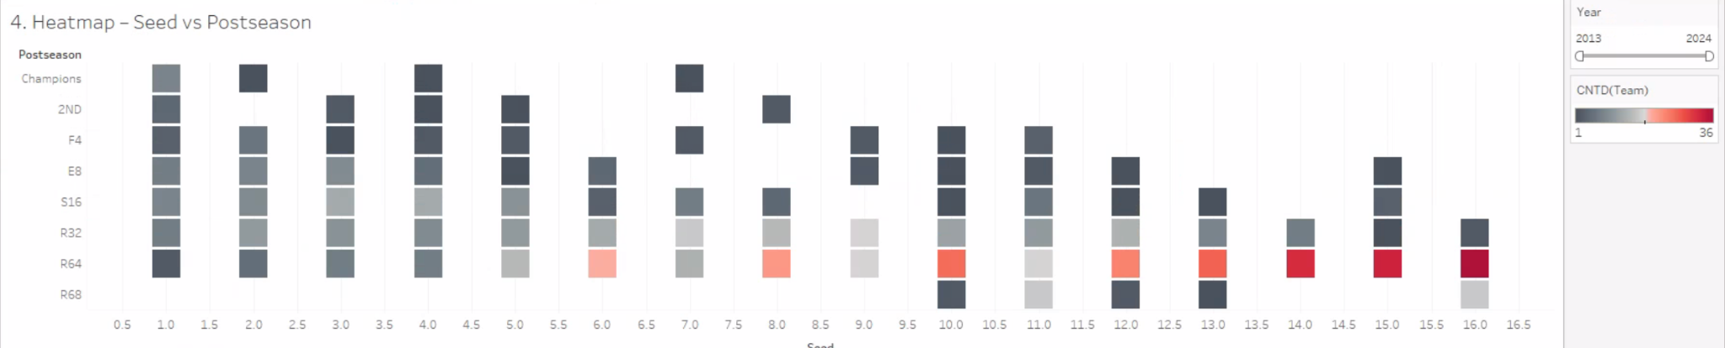
Seed vs. Postseason Round
Seeds 10–12 produce the most Cinderella runs, reaching the Elite Eight and Final Four.
These seeds offer a mix of underrated talent and favorable matchups.
Seeds above 13 rarely advance far, making 12 a practical cutoff for Cinderella models.
Notes:
Speaker Notes:
Seeds 10 through 12 have the most Cinderella activity—many have reached the Elite Eight or Final Four.
These seeds combine underrated talent with favorable matchups, making them worth scouting.
Very few teams seeded 13 or higher make deep runs, so 12 is a practical cutoff.

Slide 18
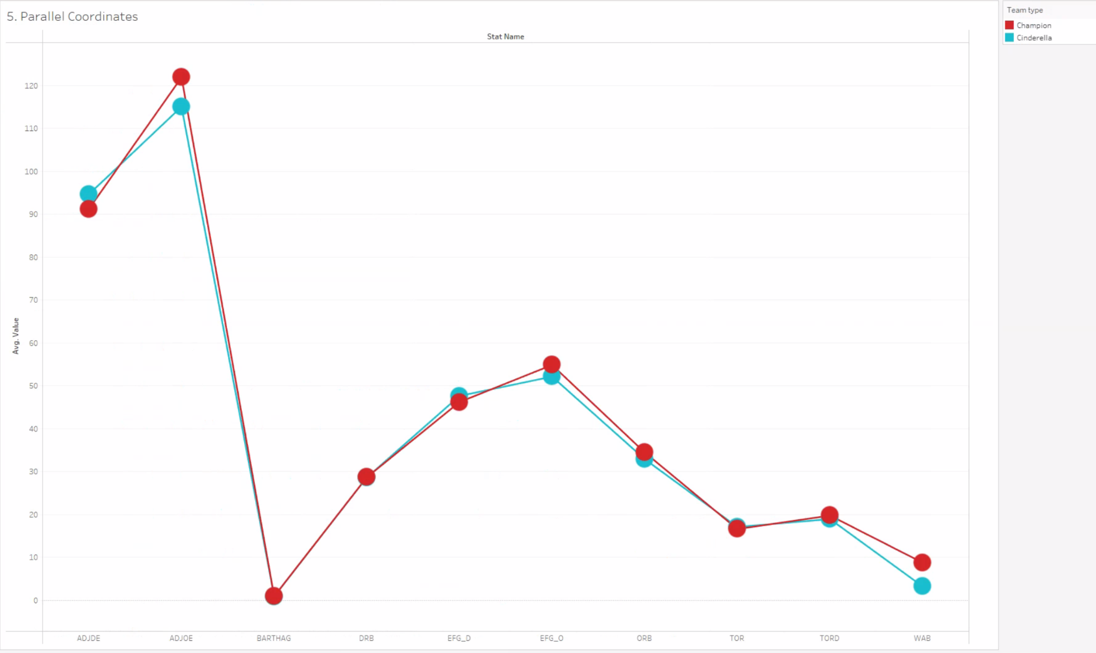
Multi-Metric Comparison
Cinderellas outperform expectations with high WAB (2.5–4.0) and moderate-to-high BARTHAG.
They force turnovers at high rates (high TORD), disrupting opponents’ rhythm.
They dominate defensive rebounding (strong DRB), limiting second-chance points.
Notes:
Speaker Notes:
Cinderellas typically outperform expectations—WAB between 2.5 and 4.0 is common.
They create chaos through high turnover rates (TORD) and lock down the boards (DRB).
Many also have solid BARTHAG scores, confirming they’re much better than their seeds imply.

Slide 19
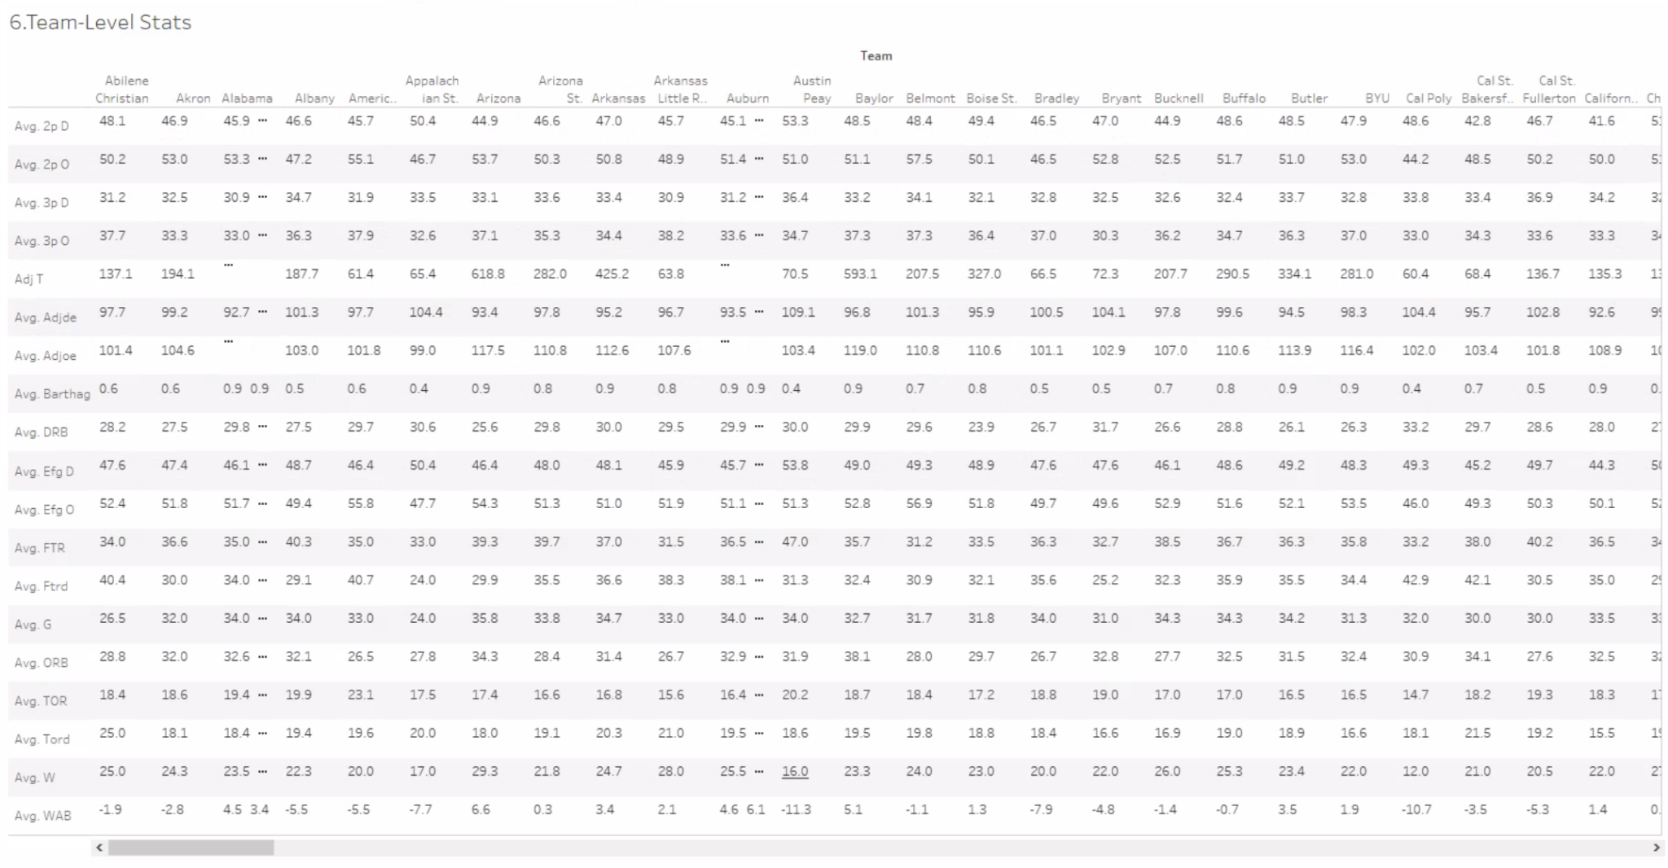
Table Level- stats
The table lets users explore real Cinderella examples like 2018 Loyola Chicago and 2021 UCLA.
These teams show the same key traits revealed in earlier charts.
This validates the model and helps spot future Cinderella candidates.
Notes:
Slide 6: Case Study Table Validates the Model
Speaker Notes:
The table lets us validate the model by comparing it to real examples like 2018 Loyola Chicago or 2021 UCLA.
These teams exhibit the same key stats we surfaced—WAB, TORD, DRB, and BARTHAG.
This cross-check gives our approach real credibility and helps identify future bracket-busters.

Slide 20
Insights from Tableau
Metric | Threshold | Why It Matters
BARTHAG | > 0.83 | Indicates statistical parity with top teams
WAB | > 2.5 | Suggests the team significantly outperformed expectations
TORD | > 20% | Points to defensive disruptiveness
DRB | > 70% | Critical for limiting opponent scoring chances
ADJDE | Low | Defensive identity is a common Cinderella edge

Slide 21
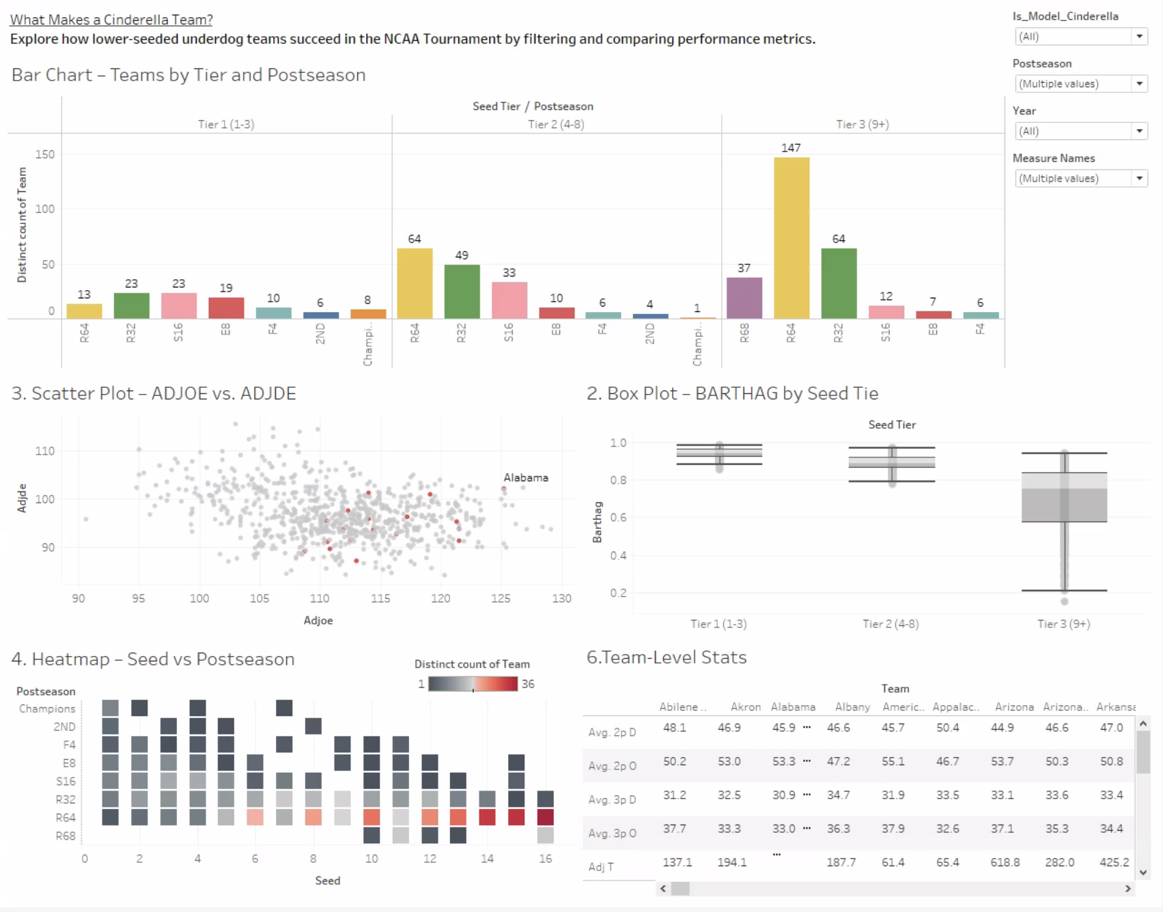
Dashboard Design
The dashboard connects exploration with practical analysis, revealing key Cinderella traits: high WAB, strong TORD, and solid DRB.
It enables real-time comparisons, trend spotting, and team-specific insights.
It’s a decision-support tool, not just a summary—built on repeatable, data-driven logic.
Notes:
Slide 7: Dashboard as Decision-Support Tool
Speaker Notes:
The dashboard isn’t just for exploration—it actively supports bracket decisions.
You can compare Cinderella teams to champions, spot trends across years, and zoom in on individual teams.
By focusing on repeatable metrics, it helps users move from gut-feeling picks to informed choices.

Slide 22
Conclusions

Slide 23
Comparison Of Methods
Aspect | Tableau | Python (Clustering)
Strengths | Visual, intuitive; good at identifying outliers and exceptions | Systematic and consistent; ideal for large-scale statistical grouping
Use Case | Exploratory pattern recognition; highlights special cases | Segmentation and modeling of full dataset based on numerical features
Limitations | May miss valid teams if excluded by filters or labels | May overlook outliers due to strict threshold criteria
Key Takeaways
Both methods independently confirmed several well-known Cinderella teams such as Loyola Chicago (2018), UCLA (2021), and Syracuse (2016).
The combination of visual storytelling and statistical modeling produced a more complete and reliable framework for analyzing tournament underdogs.
Consistent performance indicators across both methods include:
WAB > 2.5
TORD > 20%
DRB > 70%
BARTHAG > 0.83
Notes:
Slide 7: Dashboard as Decision-Support Tool
Speaker Notes:
The dashboard isn’t just for exploration—it actively supports bracket decisions.
You can compare Cinderella teams to champions, spot trends across years, and zoom in on individual teams.
By focusing on repeatable metrics, it helps users move from gut-feeling picks to informed choices.

Slide 24
Final Takeaways
Tableau = visual insight | Python = pattern discovery
Cinderellas aren’t random — they’re efficient and overlooked
This approach can inform future bracket picks

Slide 25
Thank you! Q&A

